Slide 1
Identify output devices and their uses, e.g. CRT monitor, TFT/LCD monitor, IPS/LCD monitor, LED monitor, touch screen (as an output device), multimedia projector, laser printer, inkjet printer, dot matrix printer, wide format printer, 3D printer, speakers, motors, buzzers, heaters, lights/lamps Describe the advantages and disadvantages of any of the above devices

Slide 2
 |  |  |  |  |  |  |  |  |  |  |  |  |  |  |  |  |  | 2
 |  |  |  |  |  |  |  | 1
1
 |  |  |  |  |  |  |  |  |  |  |  |  |  | 4
 |  |  |  | 3 |  |  |  |  |  |  |  |  |  |  |  |  |  |  |  | 5
 |  |  | 2
 |  |  |  |  |  |  |  |  |  |  |  |  |  |  |  |  | 5
 |  |  |  |  |  |  |  |  |  |  |  |  | 4
 |  |  |  |  |  | 3
 |  |  |  |  |  |  |  |  | 6
Down
Used by professional graphic artists
Prints high quality – low volume
Prints high quality – high volume
Outputs sound
affects or control the real world
Across
Requires more desk space
High levels of brightness
Used on phones/tablets
Used by teachers
Prints low quality – carbon copies
Prints large copies

Slide 3
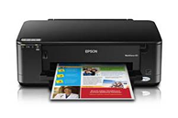
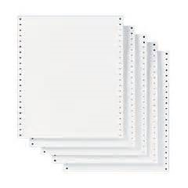
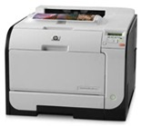
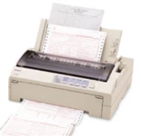
Matching the correct printer and fill in the blanks
______ quality printer.
Prints _______ copies
Prints on ____________ multi-part stationary
Laser Printer
Inkjet Printer
High quality printer used in offices to print high _________. Printing is _______ and _________ lasts long time compared to inkjet cartridge.
Dot Matrix
______ quality printer which is used when printing in ______ volumes. Printer is ______ to buy but ink runs out ________.
continuous
low
High
fast
cheap
low
tonner
quickly
Carbon
Volumes

Slide 4
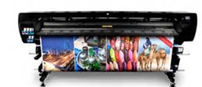
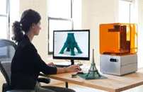
Matching the correct printer and fill in the blanks
Wide Format Printer
3D Printers can produce ______ objects by building _____ upon layer. Parts can be _______ which are no longer manufactured.
3D Printer
Wide _________ printers are generally used when ________ format printing is required. High _________ printing compared to laser and inkjet printers.
solid
format
resolution
layer
large
created
Describe the roles of actuators?

Slide 5
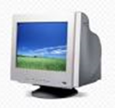

Matching the correct printer and fill in the blanks
Compare the use of CRT, LCD and IPS monitors?
Monitor | Advantage | Disadvantage
Cathode Ray Tube (CRT) Monitor
Liquid Crystal Display (LCD) Monitor

